Slide 1


Product Sales Analysis Report Using Microsoft Power BI Done By Keerthana Ramesh

Slide 2
Context of the file
The dataset contains mock retail orders of products that we can use as our template for analysis.
Order ID - An Order ID is the number system that Amazon uses exclusively to keep track of orders. Each order receives its own Order ID that will not be duplicated. This number can be useful to the seller when attempting to find out certain details about an order such as shipment date or status.
Product - The product that have been sold.
Quantity Ordered - Ordered Quantity is the total item quantity ordered in the initial order (without any changes).
Price Each - The price of each products.
Order Date - This is the date the customer is requesting the order be shipped.
Purchase Address - The purchase order is prepared by the buyer, often through a purchasing department. The purchase order, or PO, usually includes a PO number, which is useful in matching shipments with purchases; a shipping date; billing address; shipping address; and the request items, quantities and price.

Slide 3
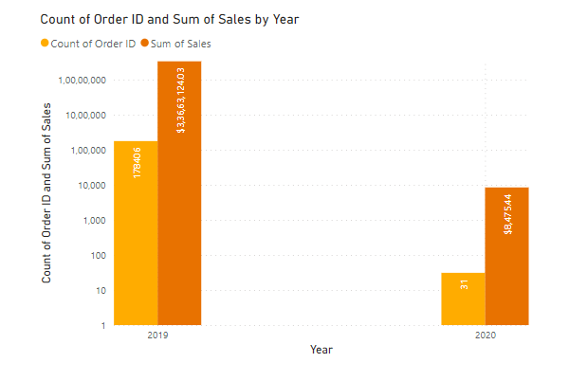
Best Year for sales
Due to imbalance dataset, Sum of Sales (99.97% decrease) and Count of Order ID (99.98% decrease) both trended down between 2019 and 2020.

Slide 4
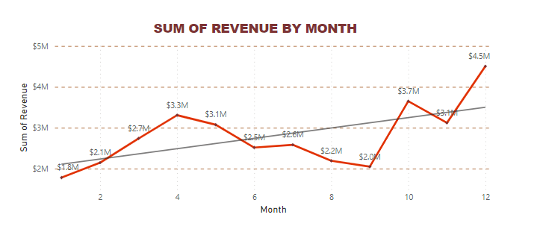
Best Month for sales
As Line chart of each month sales shows, 12th month had the highest Sales of $4.5M in a year and was 152.79% higher than 1st month, which had the lowest Sales of $1.8M.
With the help of trend line, we could see that 1,2,6,7,8,9 and11 months were not performed as expected.

Slide 5
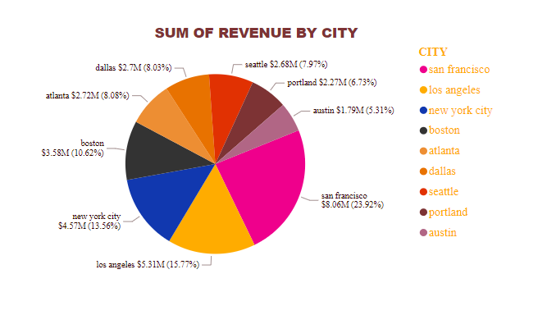
highest number of sales by city
In 2019, San francisco had the highest Sales of $8.06M which was 23.92% of sales and Austin recorded the lowest sales of $1.79M

Slide 6
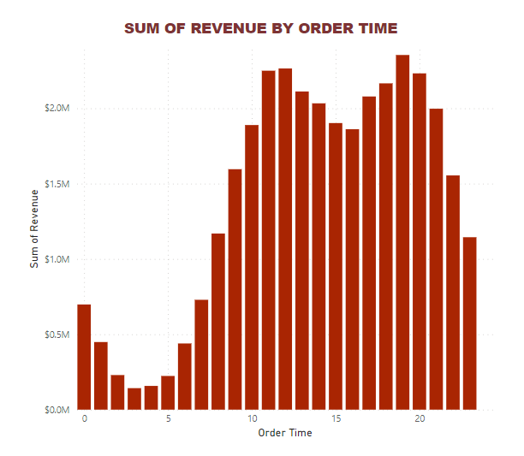
Best Time for Sales
From the graph we can see that the peak hours are 12 PM ,7 PM and 8 PM. So the best time for advertising the product would be at 9-11 AM and 4-6 PM.

Slide 7
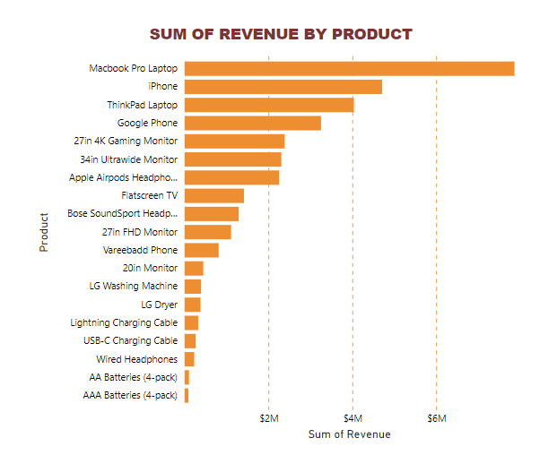
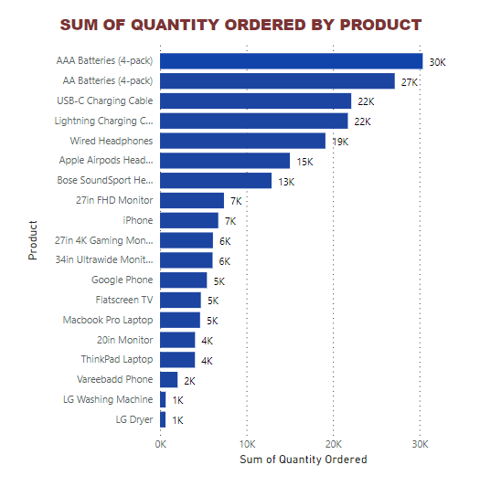
Highest revenue product & most sold product
As above data visualization shows, MacBook pro laptop was best product in terms of revenue and least was AAA batteries (4- pack) but in terms of the most sold product, AAA Batteries (4- pack) was the best one.

Slide 8
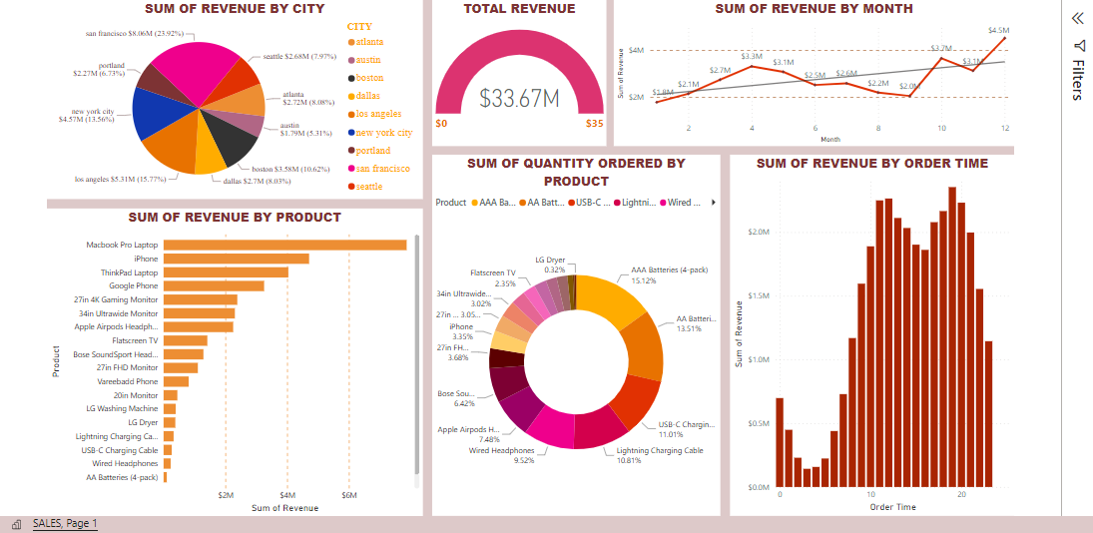
Product Sales Analysis Report

Slide 9
SUMMARY of Product Sales Analysis
In total revenue of $33.67M, 2019 had the highest sales of $33.66M compared to 2020 which only had $8,670. this is due to the lack of data in 2020 which caused a data imbalance.
The best month for most product sold was December which had a record of sales reaching $4.6M.
The city that had the most sales data was San Francisco, with total sales reaching $8.06M.
In terms of revenue, MacBook pro laptop was the best product with total revenue of $7.8M.
we can see that the peak hours are 12 PM ,7 PM and 8 PM. So the best time for advertising the product would be at 9-11 AM and 4-6 PM.
The most sold products are AAA Batteries (4-pack), AAA Batteries (4-pack), Lightning Charging Cable, USB-C Charging Cable, and Wired Headphones. This is because the prices of the products is low compared to other products, for example, the LG Dryer, or the LG Washing Machine, which have a price of around 500−700 $.

Slide 10


